Slide 1
Projet Fis’EAT
Barbary Théo
Thiry Basile
1

Slide 2
Sommaire
Architecture / Choix de conception
Répartition des tâches
Les options en plus
Analyse critique
Demonstration
1
2
3
4
5

Slide 3
Choix de conception et architecture

Slide 4
3 grandes parties
Modèle
Persistance
Fichier JSON ?
Fichier binaire ?
BDD ?
Fichier binaire
Questions :
Quel éléments ajouter dans le modèle
Comment intégrer l’aspect préparation des commandes
Comment persister les données
Cuisine

Slide 5
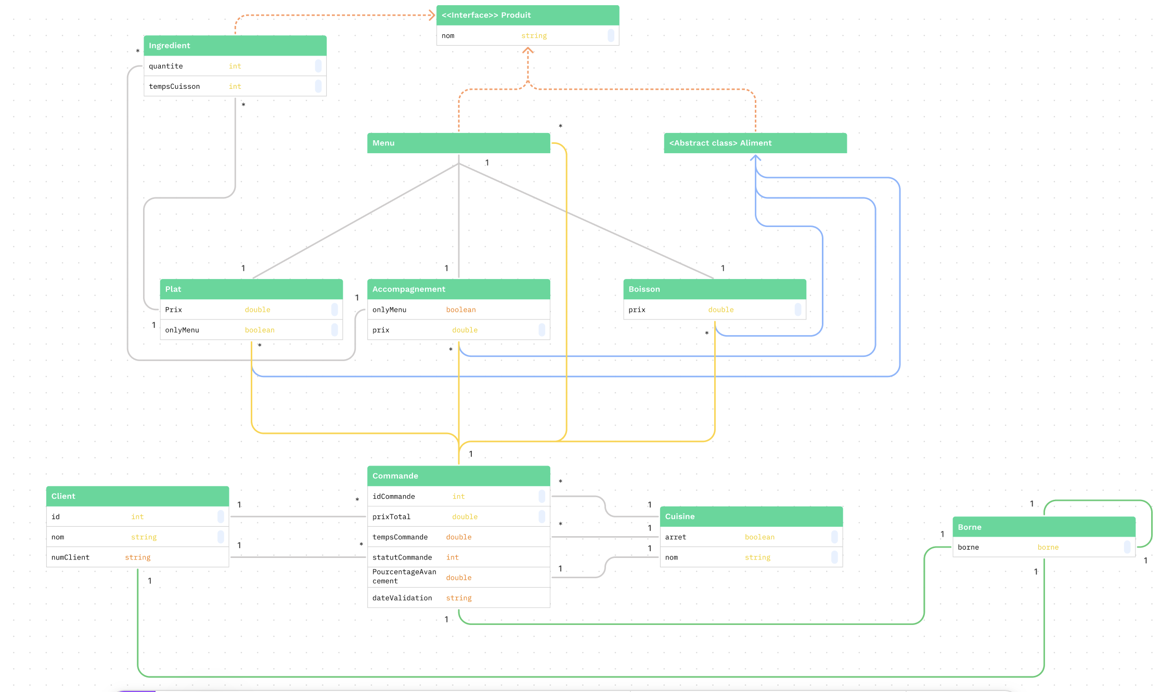

Slide 6
Répartition des tâches

Slide 7
Compétences rapport avec le projet :
Répartition des tâches en fonction de nos compétences :
BARBARY Théo | THIRY Basile
Sauvegarde | Thread
Logique POO | Logique POO
Java | Java
Design Pattern | Java FX
Spring Boot | Gradle
Basile
Théo
Implémentation des classes du modèle
Thread cuisine
Sauvegarde
Class Main
Interface login
Interface index

Slide 8
Options supplémentaires

Slide 9

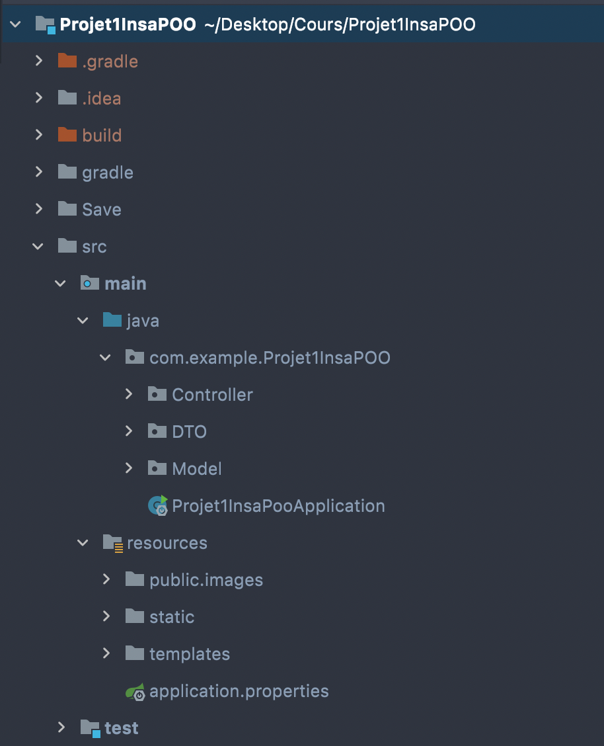
Utilisation de Spring Boot MVC
Controller : lien entre le front et le back
DTO : class permettant une transmission d’objet plus simplement
Ficher du model
Fichier css / js
Ficher html

Slide 10
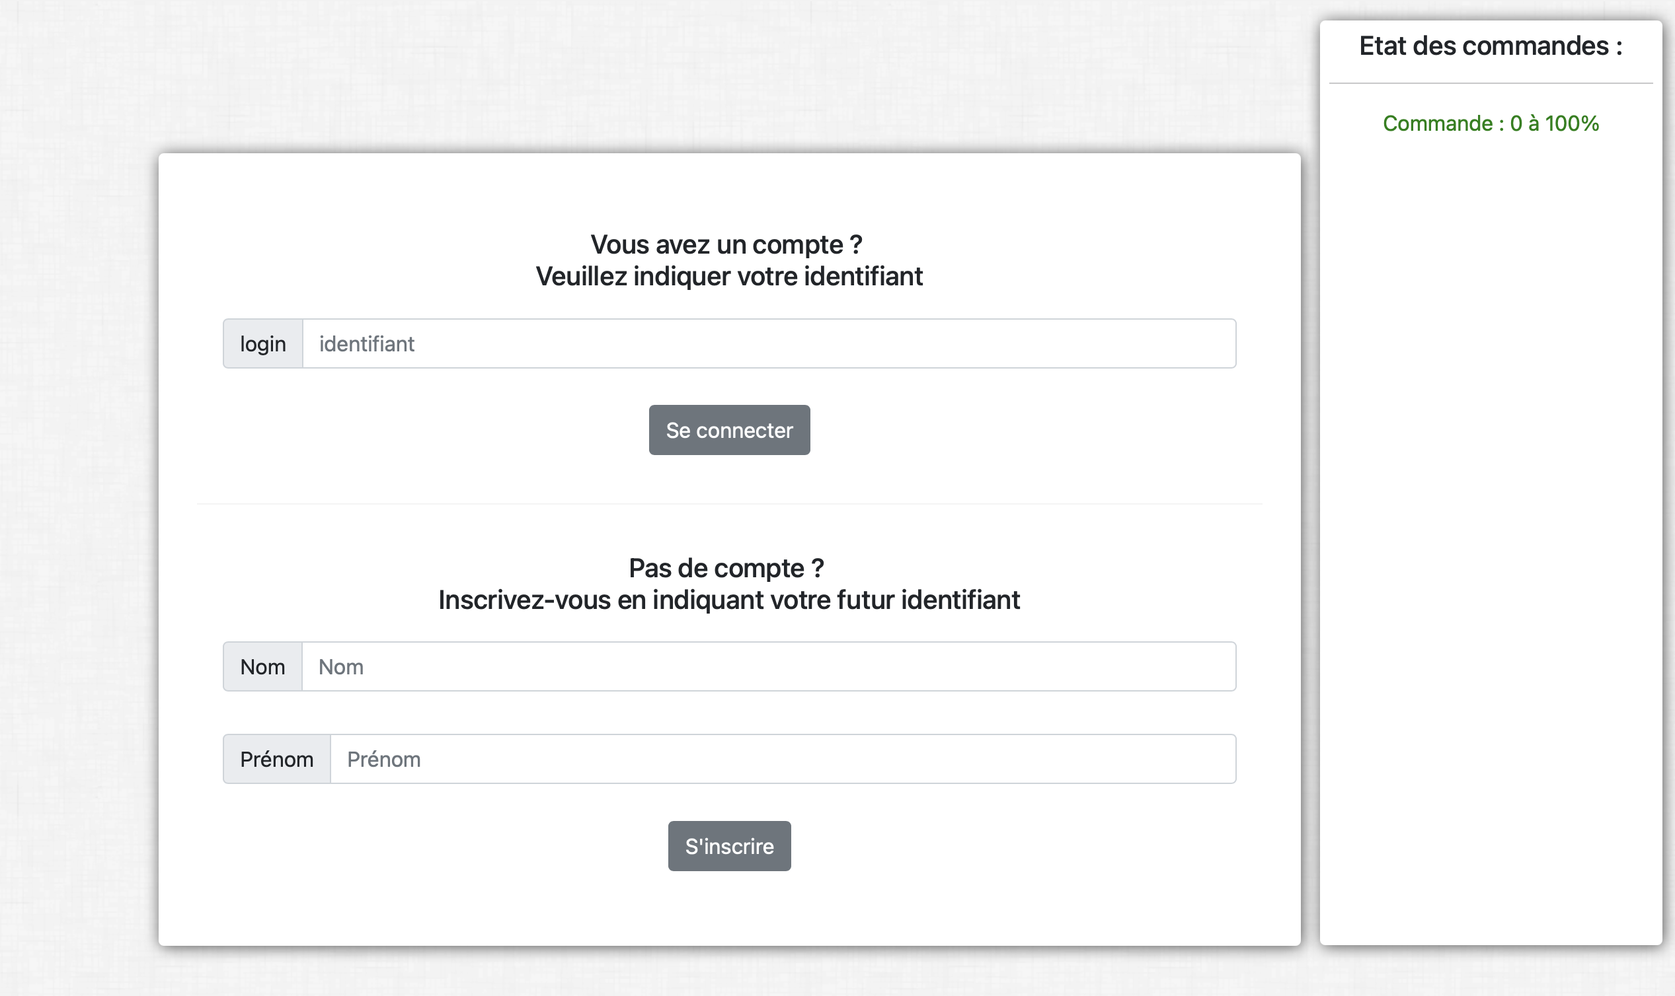
Page de connexion

Slide 11
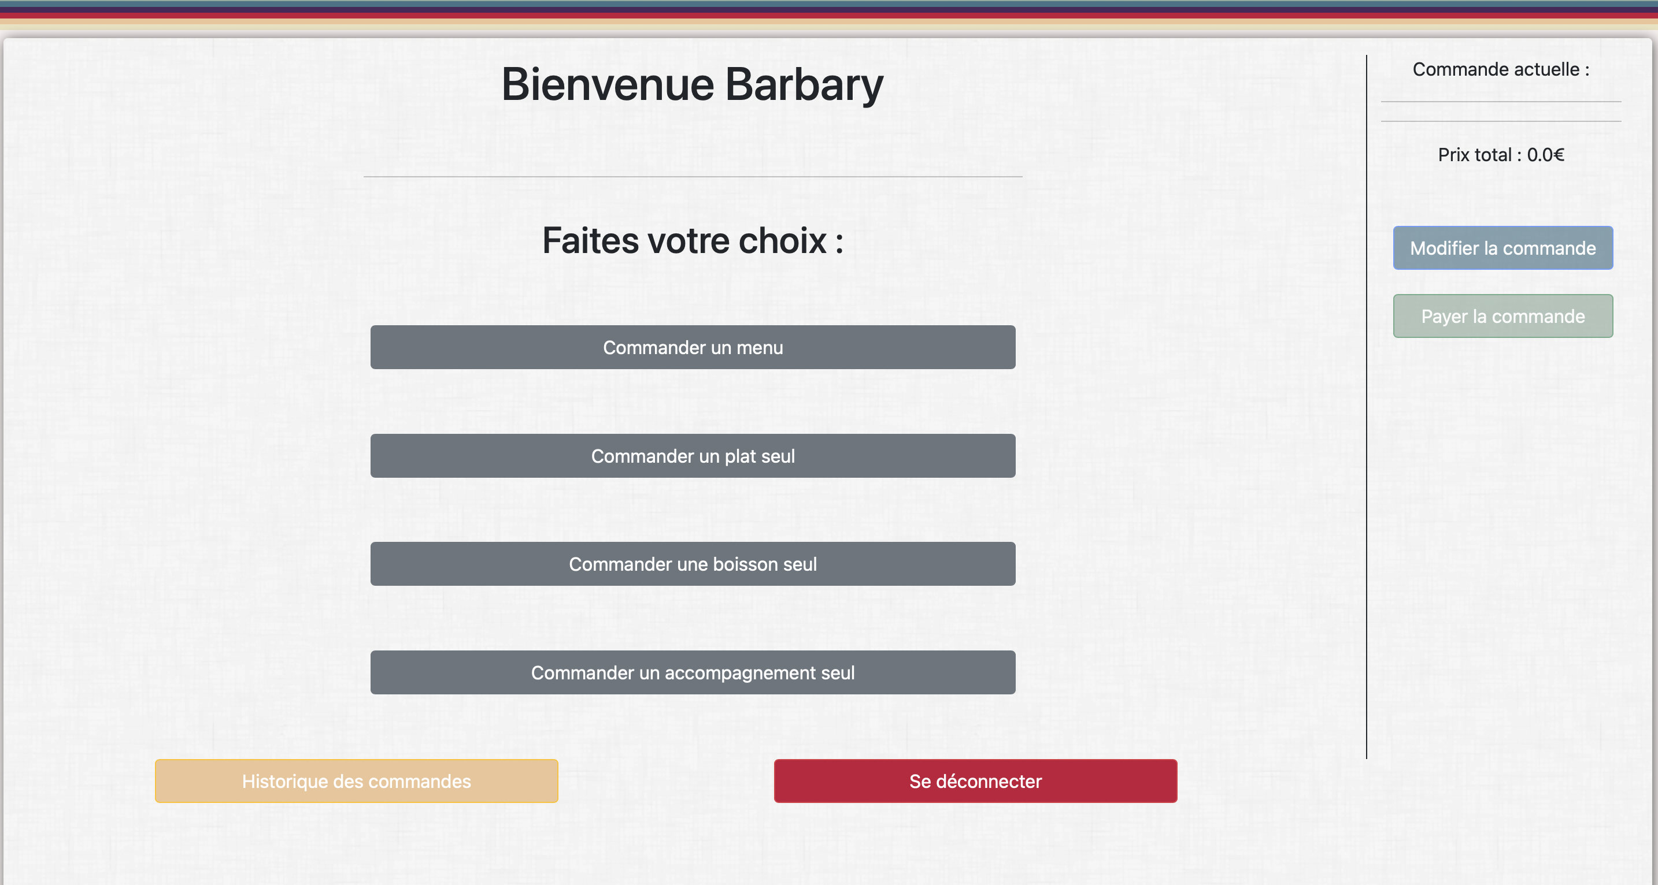
Page de principale

Slide 12
Analyse critique

Slide 13
Analyse critique
Difficultés techniques
Difficultés d’organisation

Slide 14
Démonstration

Slide 15
Customer Acquisition Infographics
Relationship
Presentation
Experience
Earth is the only planet that harbors life
Ceres is located in the main asteroid belt
Pluto is now considered a dwarf planet
Features
Assurance
Benefits
Pricing
Venus is the second planet from the Sun
Mercury is the closest planet to the Sun
Neptune is the farthest planet from the Sun
Saturn is the only planet with rings

Slide 16
Customer Acquisition Infographics
Features
Assurance
Benefits
Venus is the second planet from the Sun
Mercury is the closest planet to the Sun
Neptune is the farthest planet from the Sun
Relationship
Presentation
Experience
Earth is the only planet that harbors life
Ceres is located in the main asteroid belt
Pluto is now considered a dwarf planet

Slide 17
Customer Acquisition Infographics
Prospects | Returning visitor | Time on site | Country is France | Score
Age 20-35 | Yes | Yes | No
Male
90%
Age 35-50 | No | Yes | No
Male
75%
Age 20-35 | Yes | No | Yes
Female
55%

Slide 18
Customer Acquisition Infographics
$45M
$65M
$65M
$55M
90%
75%
60%
90%
North America
Africa
Europe
Asia
Venus is the second planet from the Sun
Mercury is the closest planet to the Sun
Neptune is the farthest planet from the Sun
Earth is the only planet that harbors life

Slide 19
Customer Acquisition Infographics
Mercury is close to the Sun
1
Awareness/Attention
Mercury is the smallest planet
It was named after a god
Jupiter is a gas giant
2
Interest
Jupiter is the biggest planet
It was named after a god, too
Venus has a beautiful name
3
Desire
Venus has high temperatures
It's close to planet Earth
Earth harbors life
4
Action
Earth is the blue planet
We’re living on this planet

Slide 20
Customer Acquisition Infographics
Nurture leads | Page visit | Manage mails | Keywords | Landing page
Segment list | Source | Publish social | On-page SEO | Web pages
Leads | Competition | Social media | Off-page SEO
Prospects | Reach
Conversion strategy | Analysis strategy | Promotion strategy | Content strategy | Visual strategy

Slide 21
Customer Acquisition Infographics
Strangers
Prospects
Mercury is the closest planet to the Sun
Attract
Saturn is composed of hydrogen and helium
Growth
Delight
Engage
Promoters
Customers
Jupiter is a gas giant and the biggest object
Despite being red, Mars is a very cold place

Slide 22
Customer Acquisition Infographics
$ total campaign spend divided by
$10 divided by
Customers acquisition cost (per campaign)
$0.40
# of customers acquired via campaign
#25
Cost per click= $0.10, customers that click Ad= 100, conversion rate= 25%
Acquisition cost= $0.10x100= $10
Customers acquired= 100x25%=40

Slide 23
Customer Acquisition Infographics
Earth is the only planet that harbors life
Awareness
90%
Mercury is the closest planet to the Sun
Interest
80%
Neptune is the farthest planet from the Sun
Desire
75%
Pluto is now considered a dwarf planet
Action
95%

Slide 24
Customer Acquisition Infographics
Features
Relationship
Mercury is the smallest planet of them all
Venus is the second planet from the Sun
Assurance
Presentation
Saturn is a gas giant and has several rings
Despite being red, Mars is actually a cold place
Benefits
Experience
Jupiter is the biggest planet of them all
Earth is the planet where we all live on

Slide 25
Customer Acquisition Infographics
Sales funnel
Customer lifecycle
Leads
Visitor
Marketing team
Mercury is the smallest planet of them all
MQL
Prospect
SQL
Sales team
Opportunity
Activated user
Saturn is a gas giant and has several rings
POP
Customer
Customer team
Renew
Activated customer
Jupiter is the biggest planet of them all
Loyal customer

Slide 26
Customer Acquisition Infographics
55%
80%
Marketing
Sales
Saturn, the ringed planet, is composed of hydrogen and helium
Jupiter is a gas giant and the biggest planet in the Solar System

Slide 27
Customer Acquisition Infographics
Target market
15 million
Unaware
Target market
14 million
12 million
Not tried
Tried
4 million
8 million
Negative opinion
Neutral opinion
Favorable opinion
1 million
1 million
2 million

Slide 28
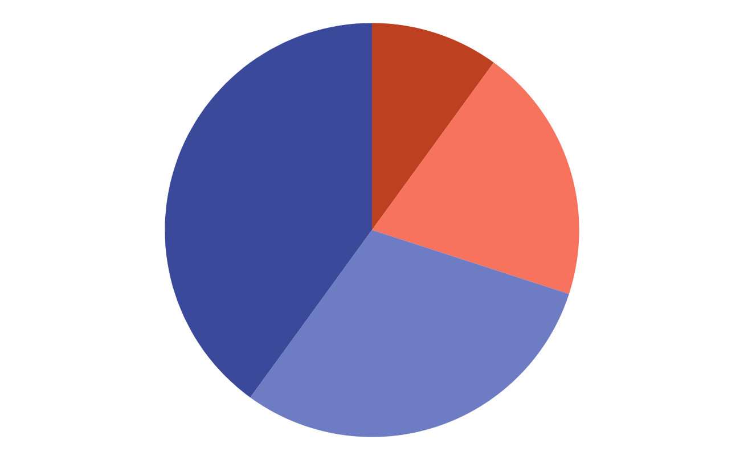
Customer Acquisition Infographics
40%
10%
Conversion
Promotion
Mars is actually a very cold place
Venus is the second planet from the Sun
30%
20%
Analysis
Content
Mercury is the closest planet to the Sun
Neptune is the farthest planet from the Sun
Follow the link in the graph to modify its data and then paste the new one here. For more info, click here

Slide 29
Customer Acquisition Infographics
 | Acquisition April 2021 summary
 | Conversion strategy | Analysis strategy | Promotion strategy | Content strategy
Week 1 | 525 | 420 | 150 | 210
Week 2 | 530 | 430 | 160 | 320
Week 3 | 540 | 440 | 170 | 430
Week 4 | 550 | 450 | 180 | 540

Slide 30
Customer Acquisition Infographics
Awareness
30%
Earth is the only planet that harbors life
Interest
30%
Venus is the second planet from the Sun
Desire
20%
Pluto is now considered a dwarf planet
Action
20%
Jupiter is a gas giant and the biggest planet

Slide 31
Customer Acquisition Infographics
Awareness
02
Desire
04
Venus is the second planet from the Sun
Mercury is the closest planet to the Sun
01
Interest
03
Action
Earth is the only planet that harbors life
Ceres is located in the main asteroid belt

Slide 32
Customer Acquisition Infographics
Target market
Multi segment market
Concentrated market
Negative
Positive
Negative
Positive
Despite being red, Mars is actually a very cold place
Saturn, the ringed planet, is composed of hydrogen and helium
Jupiter is a gas giant and the biggest planet in the Solar System
Mercury is the closest planet to the Sun and the smallest one

Slide 33
Customer Acquisition Infographics
Planning
Mercury is the smallest planet in the Solar System
Strategy
Saturn is a gas giant and has several rings
Marketing
Jupiter is the biggest planet in the Solar System
Promotion
Despite being red, Mars is actually a cold place
Sales
Earth is the planet that harbors life

Slide 34
Customer Acquisition Infographics
Customer lifecycle
Visitor
Lead
Secured
Customer
Active user
Venus is the second planet from the Sun
Mercury is the closest planet to the Sun
Neptune is the farthest planet from the Sun
Pluto is now considered a dwarf planet
Earth is the only planet that harbors life
01
02
03
04
05
Awareness
Education
Conversion
Engagement
Deal
Saturn is a gas giant and has several rings
The Moon is Earth’s only natural satellite
Despite being red, Mars is actually a cold place
Uranus is the seventh planet from the Sun
Jupiter is the biggest planet in the Solar System
Sales funnel

Slide 35
Customer Acquisition Infographics
Mercury is the smallest planet
Mars is full of iron oxide dust
Saturn is a gas giant and has rings
Earth is the planet that harbors life
Conversion
It’s composed of hydrogen and helium
It’s the biggest planet in the Solar System
Neptune is the farthest planet
Venus is the second planet from the Sun
Analysis
Ceres is located in the asteroid belt
It’s the coldest planet of them all
Earth is where we all live on
Venus has a really beautiful name
Promotion
Mars is actually a very cold place
It’s the sixth planet from the Sun
The Moon is our natural satellite
The Sun is the closest star to Earth
Content

Slide 36
Customer Acquisition Infographics
Personal info
Motivations
Incentive:
Saving money
Age:
20-35
Behaviour:
Rational
Gender:
Male
Personality:
Shy
Location:
France
Studies:
Maths
Free time
Level:
Degree
Marital Status:
Married
Music
Occupation:
Math teacher
Reading
Income Range:
$1900-$2400
Traveling

Slide 37
Customer Acquisition Infographics
Step 01
Mercury is the smallest planet of them all
Attract
Step 02
Saturn is a gas giant and has several rings
Convert
Step 03
Jupiter is the biggest planet of them all
Engage
Step 04
Despite being red, Mars is actually a cold place
Connect
Step 05
Venus is the second planet from the Sun
Sell

Slide 38
Customer Acquisition Infographics
Attract
Mercury is the closest planet to the Sun
50 %
Engage
Venus is the second planet from the Sun
25 %
Delight
Neptune is the farthest planet from the Sun
30%

Slide 39
Customer Acquisition Infographics
1
2
3
4
Conversion
Analysis
Promotion
Content
Mercury is the closest planet to the Sun and also is the smallest one
Venus has a beautiful name, but also high temperatures
Jupiter is a huge gas giant named after a Roman god
Despite being red, Mars is a cold place full of iron oxide dust

Slide 40
Customer Acquisition Infographics
Marketing
Mercury is a small planet
Attract
Content
Venus has a beautiful name
Help
Jupiter is the biggest planet
Customer
Delight
Support
Saturn is the ringed planet
Relationships
Mars is a cold planet
Engage
Sales
Pluto is a dwarf planet

Slide 41
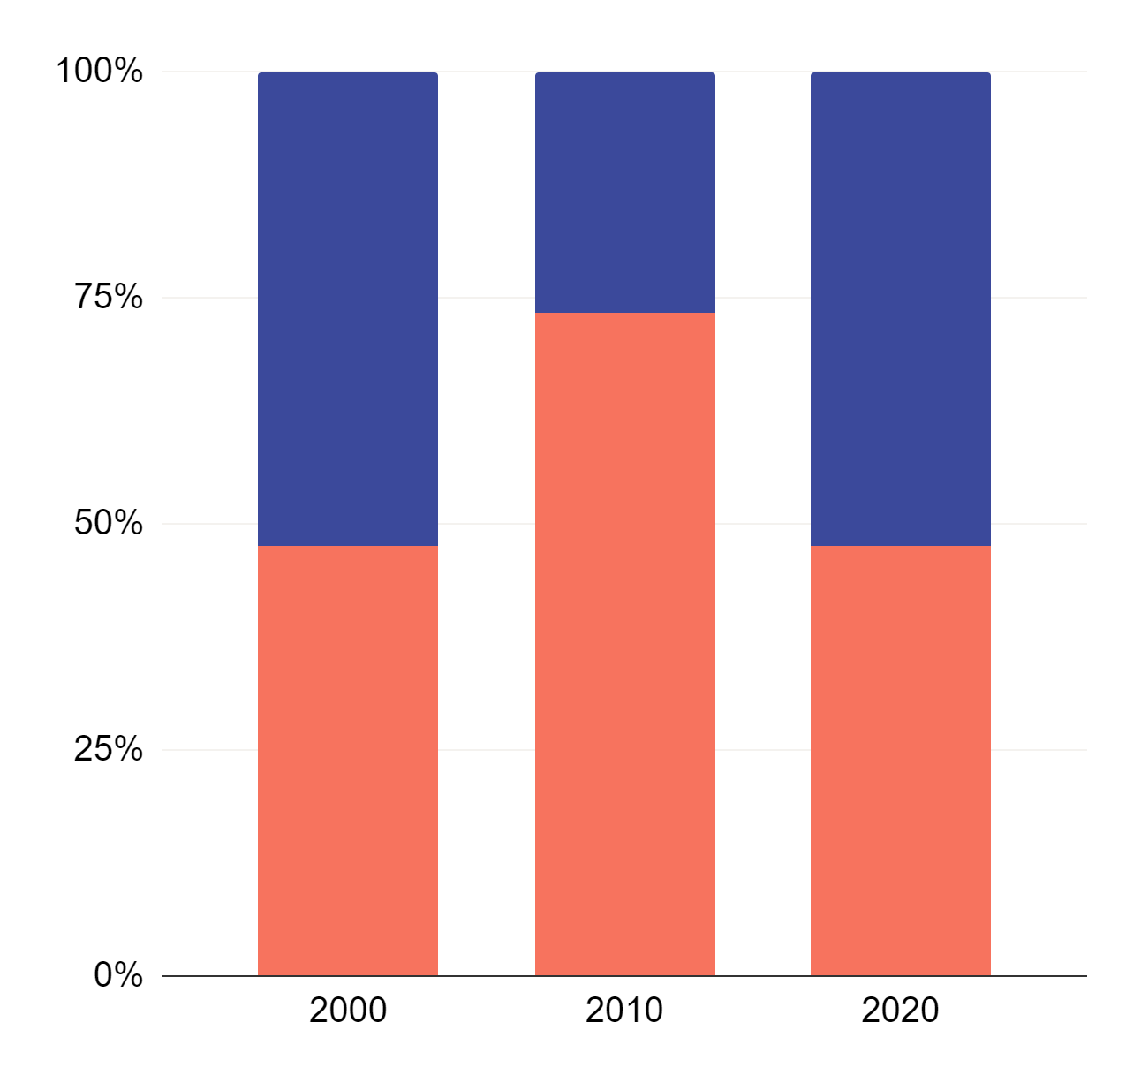
Customer Acquisition Infographics
Conversion
Venus is the second planet from the Sun
Analysis
Saturn is a gas giant and has rings
Follow the link in the graph to modify its data and then paste the new one here. For more info, click here

Slide 42
Customer Acquisition Infographics
Planning
Strategy
Neptune is the farthest planet from the Sun
Venus is the second planet from the Sun
Promotion
Marketing
Despite being red, Mars is a cold place
Mercury is the closest planet to the Sun
Sales
Customers
Pluto is now considered a dwarf planet
Jupiter is a gas giant and the biggest planet

Slide 43
Customer Acquisition Infographics
25%
50%
75%
75%
90%
Attract
Convert
Engage
Sell
Connect
Venus is the second planet from the Sun
Mercury is the closest planet to the Sun
Neptune is the farthest planet from the Sun
Pluto is now considered a dwarf planet
Earth is the only planet that harbors life

Slide 44
Customer Acquisition Infographics
 |  | Week 01 | Week 02 | Week 03 | Week 04
Volume | Visits | 920 | 936 | 976 | 987
 | Leads | 351 | 362 | 375 | 382
 | Sales | 50 | 55 | 60 | 65
Conversion | % Lead/visit | 14% | 16% | 18% | 21%
 | % Sales/lead | 22% | 24% | 27% | 29%
 | % Sales/visit | 4% | 6% | 8% | 9%
Cost | CPC | 0.75 | 0.77 | 0.83 | 0.86
 | CPL | 4.30 | 4.36 | 4.42 | 4.57
 | CAC | 16.21 | 17.24 | 19.33 | 19.59

Slide 45
Instructions for use (premium users)
If you are a Premium user on Slidesgo, you can use this template without crediting Slidesgo.
You are allowed to:
Modify this template.
Use it for both personal and commercial purposes.
Hide or delete the “Thanks” slide and the mention to Slidesgo in the credits.
Share this template in an editable format with people who are not part of your team.
You are not allowed to:
Sublicense, sell or rent this Slidesgo Template (or a modified version of this Slidesgo Template).
Distribute this Slidesgo Template (or a modified version of this Slidesgo Template) or include it in a database or in any other product or service that offers downloadable images, icons or presentations that may be subject to distribution or resale.
Use any of the elements that are part of this Slidesgo Template in an isolated and separated way from this Template.
Register any of the elements that are part of this template as a trademark or logo, or register it as a work in an intellectual property registry or similar.
For more information about editing slides, please read our FAQs or visit Slidesgo School:
https://slidesgo.com/faqs and https://slidesgo.com/slidesgo-school

Slide 46
Infographics
You can add and edit some infographics to your presentation to present your data in a visual way.
Choose your favourite infographic and insert it in your presentation using Ctrl C + Ctrl V or Cmd C + Cmd V in Mac.
Select one of the parts and ungroup it by right-clicking and choosing “Ungroup”.
Change the color by clicking on the paint bucket.
Then resize the element by clicking and dragging one of the square-shaped points of its bounding box (the cursor should look like a double-headed arrow). Remember to hold Shift while dragging to keep the proportions.
Group the elements again by selecting them, right-clicking and choosing “Group”.
Repeat the steps above with the other parts and when you’re done editing, copy the end result and paste it into your presentation.
Remember to choose the “Keep source formatting” option so that it keeps the design. For more info, please visit Slidesgo School.

